Slide 1
Transmission Lines
Vector Network Analyzer
June 18, 2024
Stephen Wilde

Slide 2
Transmission Lines
Routes the source voltage from the transmitter, filter, or combiner system to the antenna system. Routes receive signals from antenna system to receiver.
Types of Transmission Line:
Coax, Heliax
Rigid Transmission line
Waveguide

Slide 3
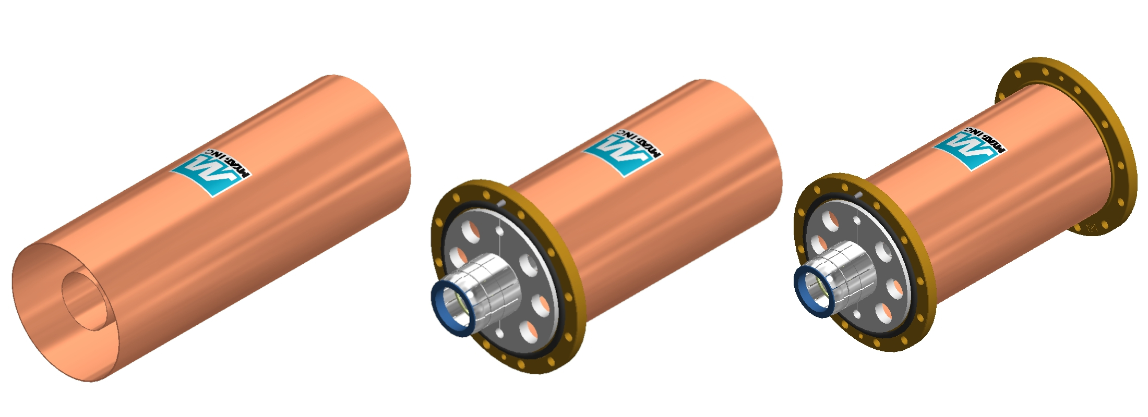
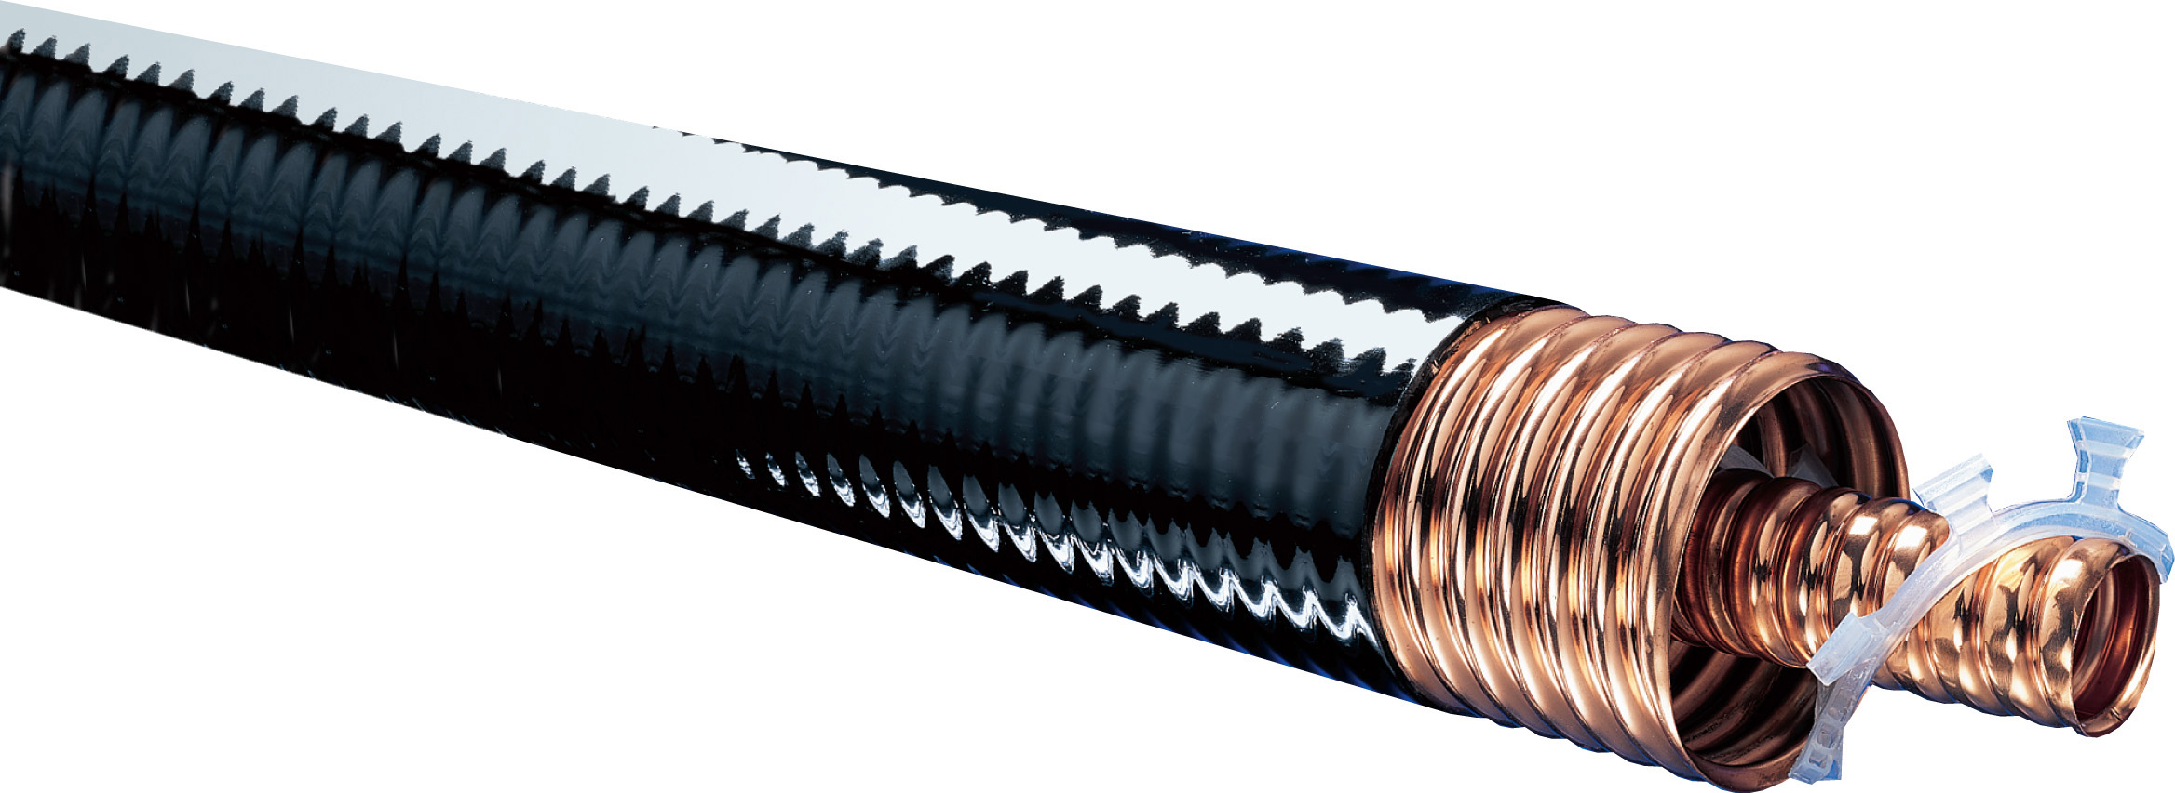
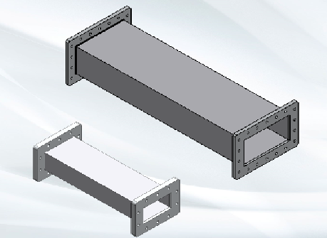
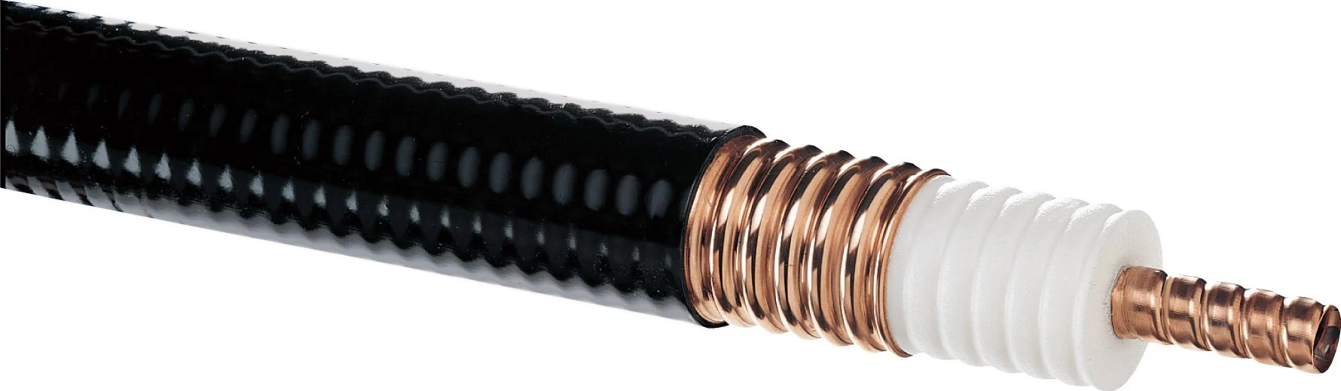
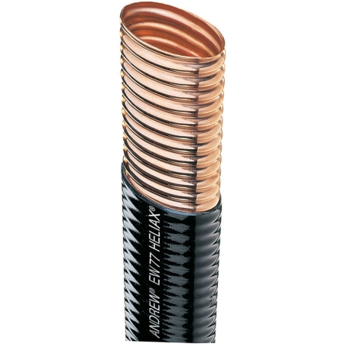

Slide 4
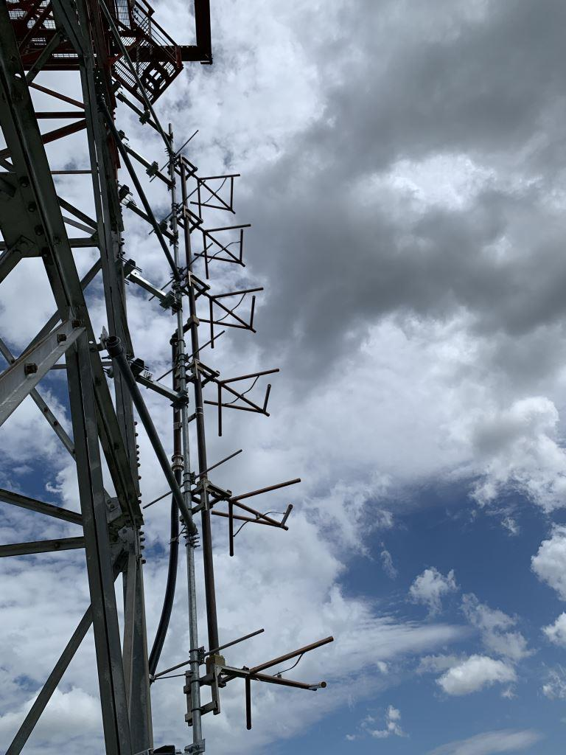

Slide 5
Impedance
Typically transmission lines have an impedance of 50 ohms. Impedance ( Z ) = 50 +/- j0
However, there are many high power TV broadcast circuits that use 75 ohm transmission line. 6-1/8’’, 7-3/16’’ and 8-3/16’’ are three popular sizes for high power 75 ohm transmission lines.

Slide 6
Vector Network Analyzer
A test instrument that generates a source voltage used to analyze passive and/or active circuits.
When used for broadcast transmission systems, it is typically used to measure and troubleshoot passive circuits, such as transmission lines, antenna systems, and filter/combiner systems.

Slide 7
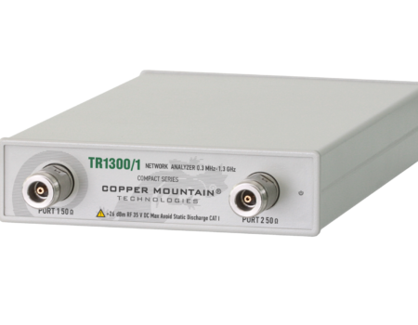
Copper Mountain TR1300/1

Slide 8
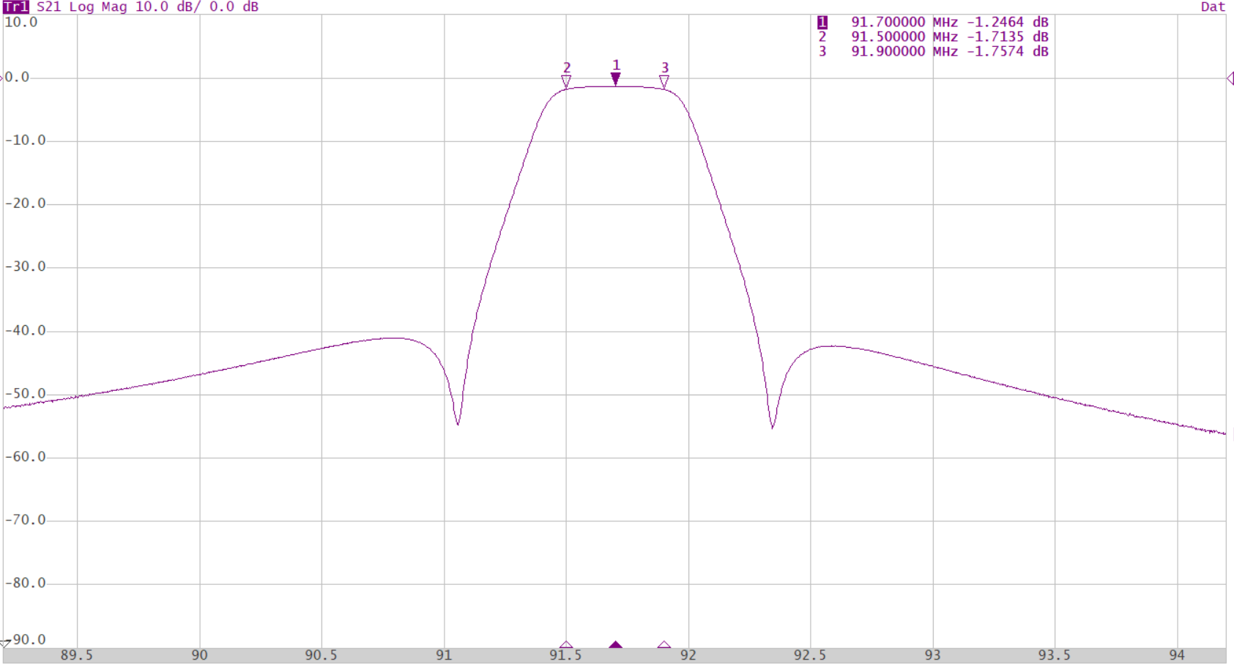
Frequency Domain
Frequency Increases left to right

Slide 9
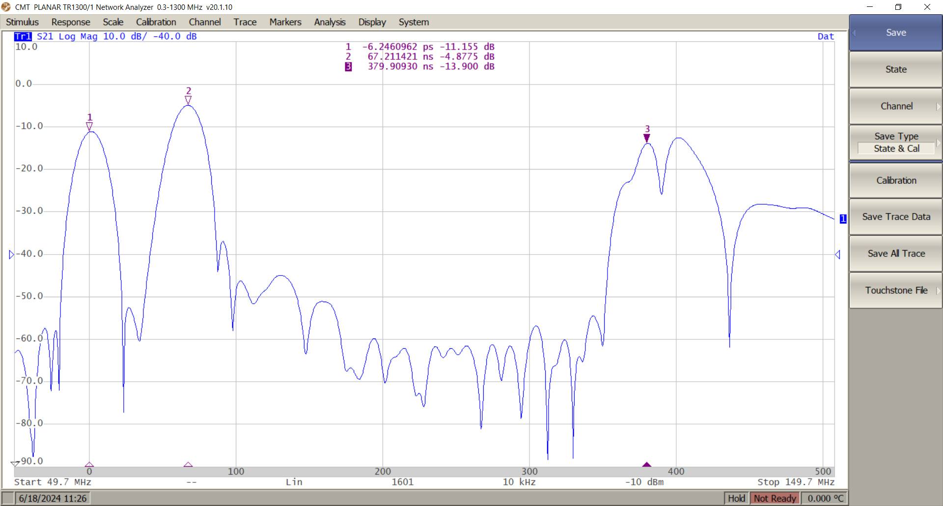
Time Domain (Distance)
Time (Distance) left to right

Slide 10
Summary
VNA’s (Vector Network Analyzers) are extremely useful for troubleshooting and analyzing transmission systems. When used correctly, the information gathered can reduce the time and expenses when installing new equipment or troubleshooting existing circuits.

